Slide 1


Labview Based Monitoring System Applied For Characteristics Of Photovoltaic Modules
Abdulkadir MÜHENDİS, M.Sc. Candidate, Selçuk University

Slide 2

CONTENTS
OUTLINE OF THIS WORK
Maximum Power Point Tracking
NI-Labview
1
3
5
MPPT Concepts
Incremental Conductance Method
Software Implementation
User Interface
Block Diagram
Conclusion
Photovoltaic Characteristics
Instructional Approach
System Operation and Experimental Results
2
4
6
Engineering Laboratiories
Digital learning Materials
Solar Cell Characteristics
Solar Module Structures
PV Mathimatical Model
Incremental Conductance Algorithim
Design Approach
I-V Curves Analysis
Sub-VIs Implementation
Main Block Diagram Structures
Real Solar Module Simulation
2ndIITEEC 2019’ International Instructional Technologies in Engineering Education Conference, 12th – 13th March 2019 Ege University – Izmir/Turkey

Slide 3
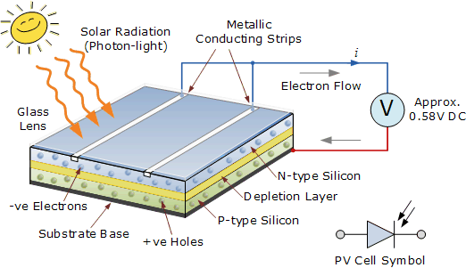
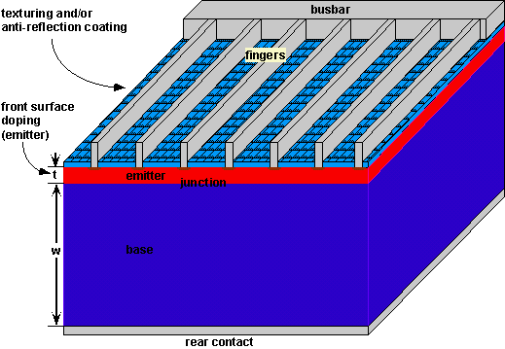
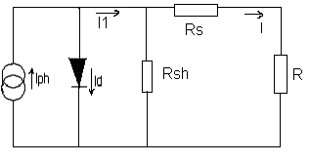
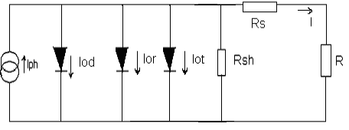
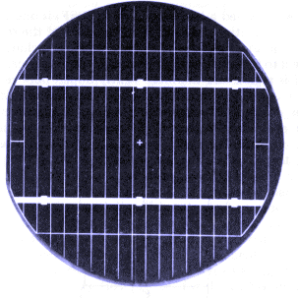
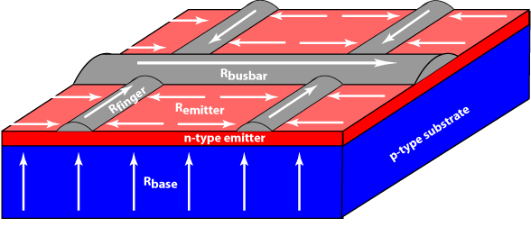
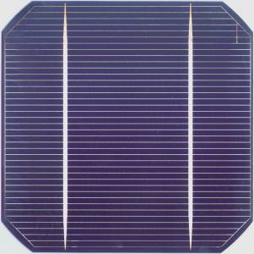
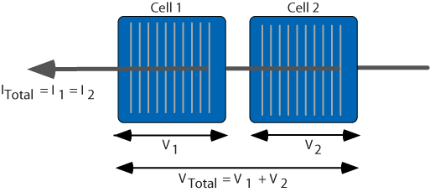
Photovoltaic Characteristics
Solar Cells
2ndIITEEC 2019’ International Instructional Technologies in Engineering Education Conference, 12th – 13th March 2019 Ege University – Izmir/Turkey

Slide 4
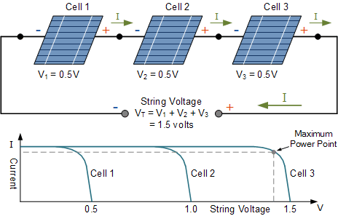
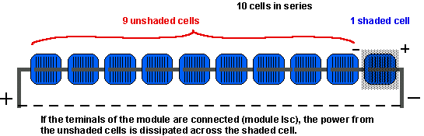
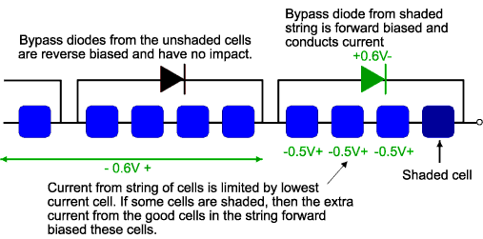
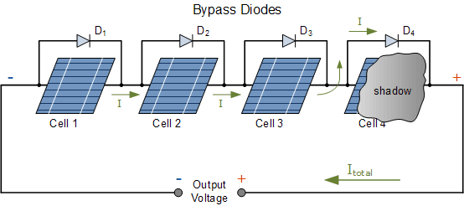
Photovoltaic Characteristics
Solar Cells
2ndIITEEC 2019’ International Instructional Technologies in Engineering Education Conference, 12th – 13th March 2019 Ege University – Izmir/Turkey

Slide 5
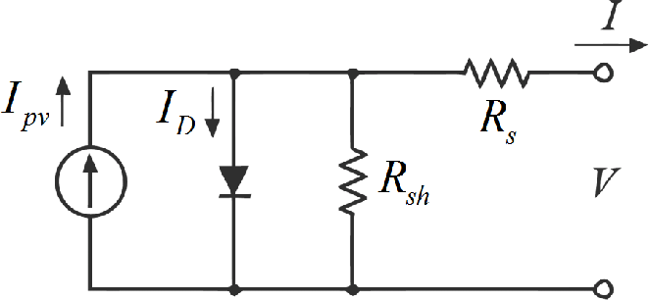
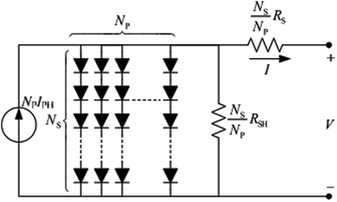
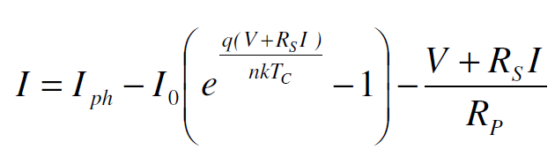
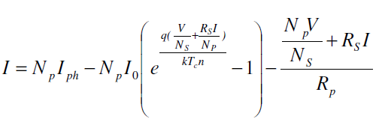
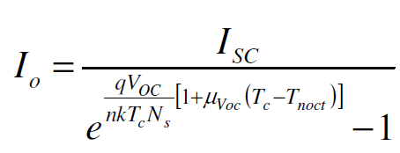
Photovoltaic Characteristics
Solar Modules
PV cell model
PV MODULE MODEL
A photovoltaic cell consists of a p-n junction that emits electrons when exposed to light, which is known as photovoltaic effect. The solar cell can be modeled as a current source which represents the solar irradiation, in parallel with a forward biased diode.
Photovoltaic modules consist of a number of silicon based photovoltaic cells electrically connected in series and in parallel circuits, depending on the voltage or current requirements
No Analytical Solution !
2ndIITEEC 2019’ International Instructional Technologies in Engineering Education Conference, 12th – 13th March 2019 Ege University – Izmir/Turkey

Slide 6
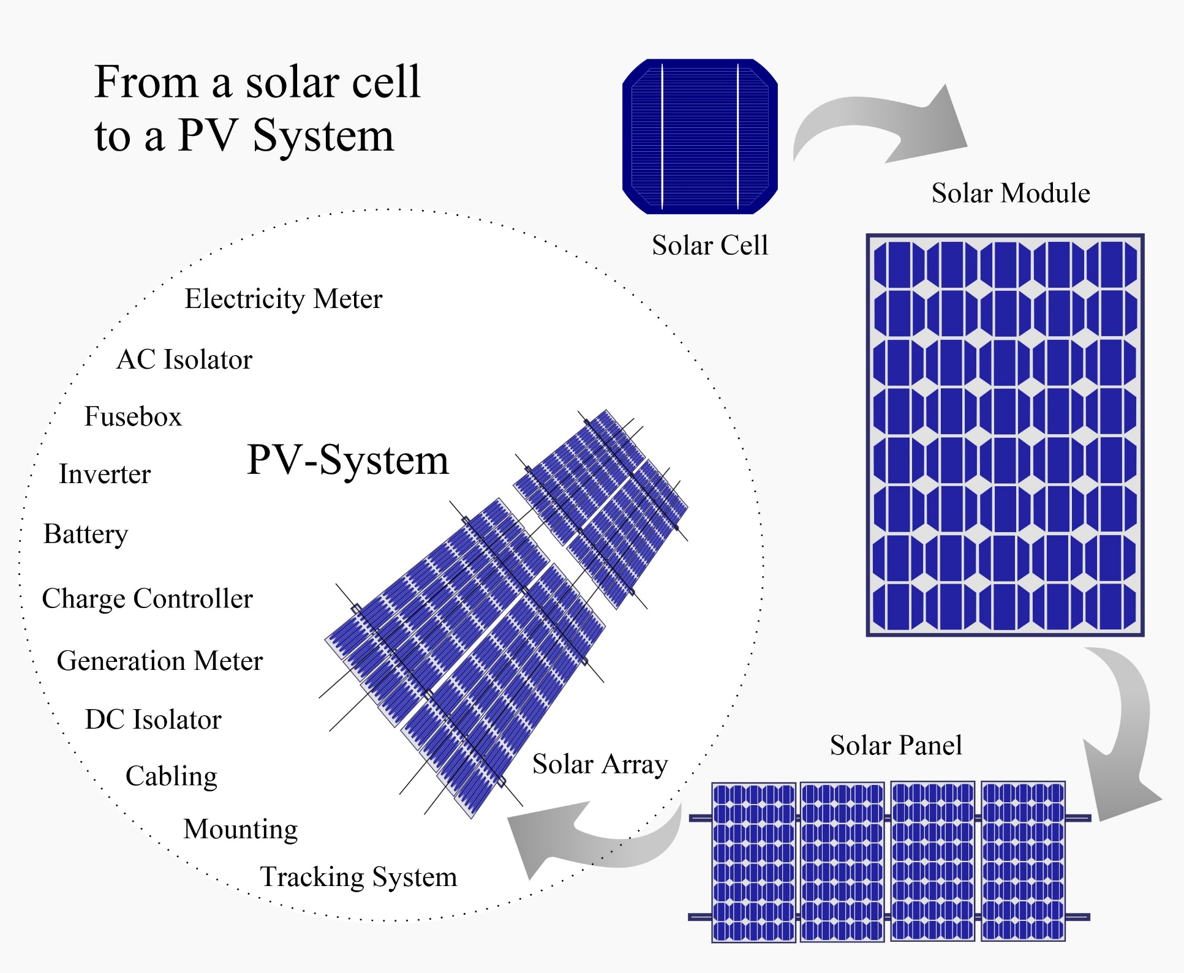
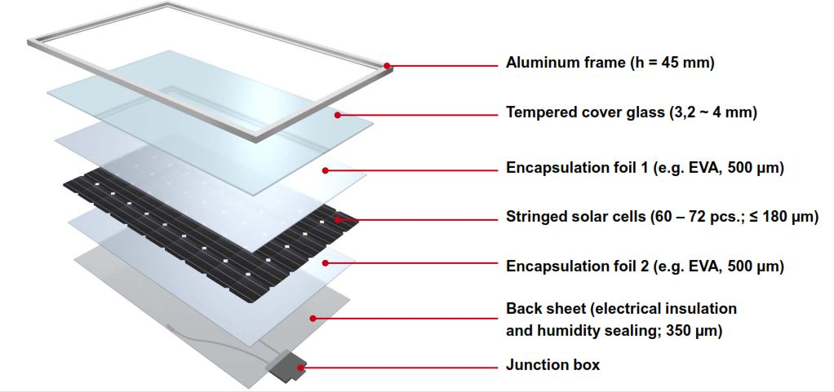
Photovoltaic Characteristics
Solar Modules
2ndIITEEC 2019’ International Instructional Technologies in Engineering Education Conference, 12th – 13th March 2019 Ege University – Izmir/Turkey

Slide 7
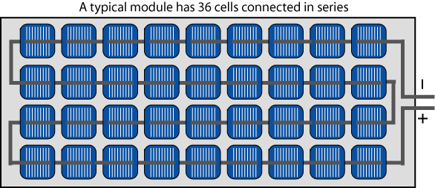
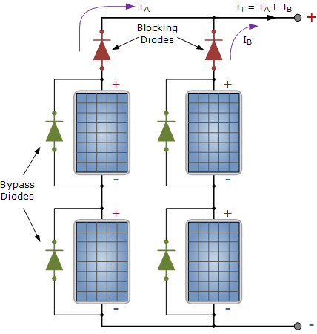
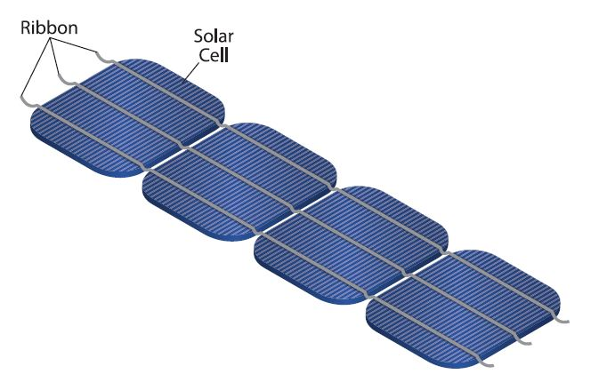
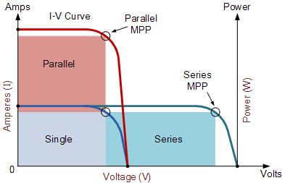
Photovoltaic Characteristics
Solar Modules
2ndIITEEC 2019’ International Instructional Technologies in Engineering Education Conference, 12th – 13th March 2019 Ege University – Izmir/Turkey

Slide 8
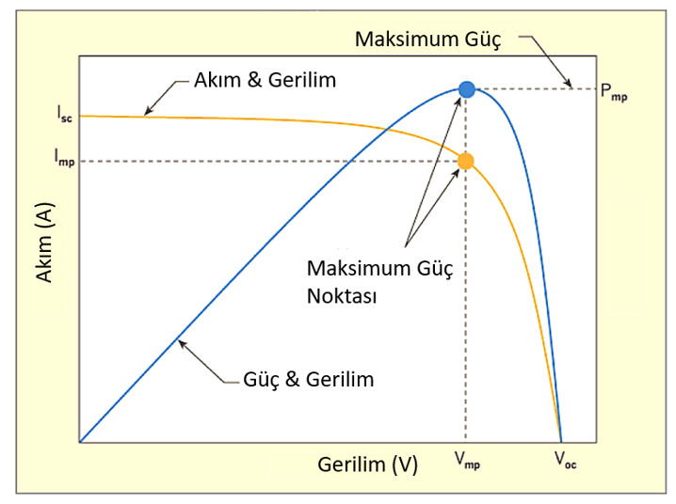
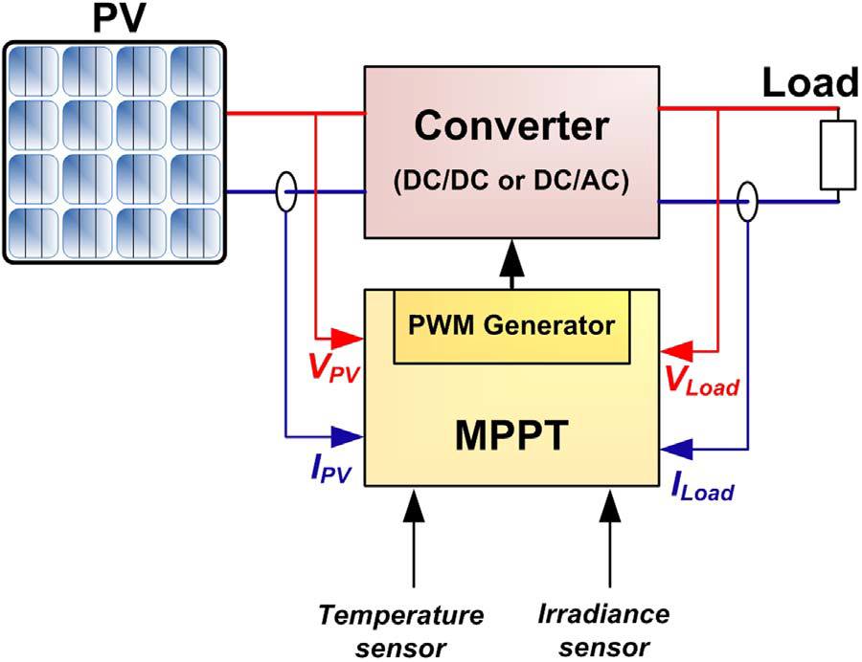
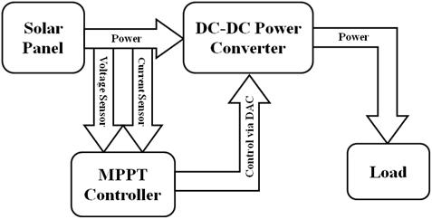
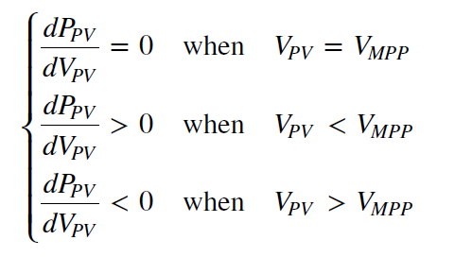
Maximum Power Point Tracking
Mppt Concepts
2ndIITEEC 2019’ International Instructional Technologies in Engineering Education Conference, 12th – 13th March 2019 Ege University – Izmir/Turkey

Slide 9
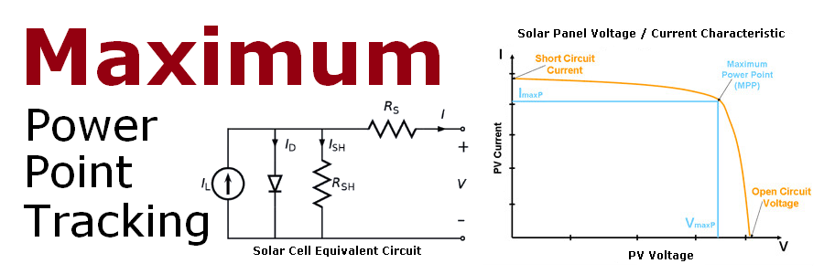
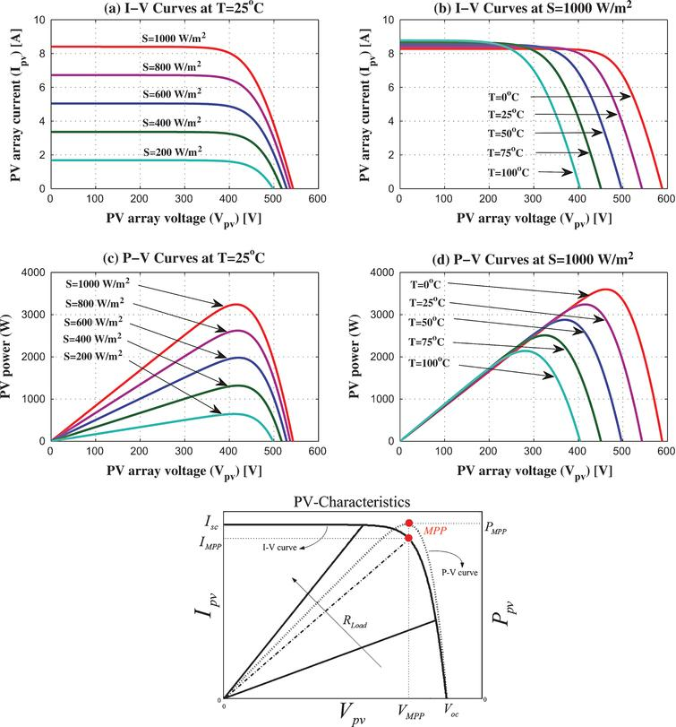
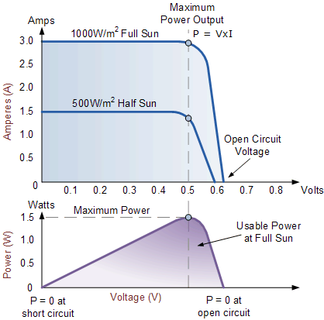
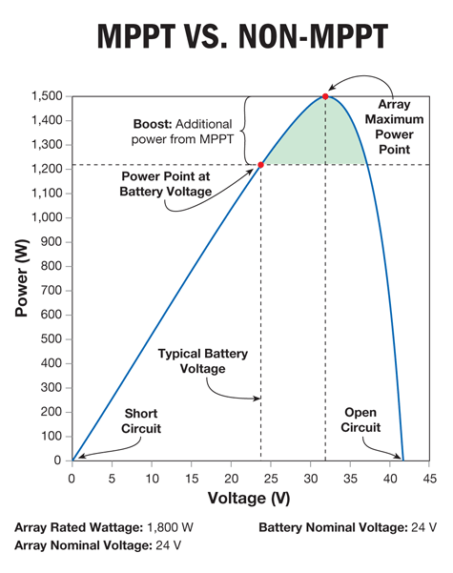
Maximum Power Point Tracking
Mppt Curves
2ndIITEEC 2019’ International Instructional Technologies in Engineering Education Conference, 12th – 13th March 2019 Ege University – Izmir/Turkey

Slide 10
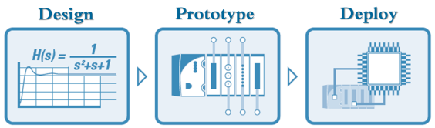
Maximum Power Point Tracking
Design Approach
Diagram of grid-connected photovoltaic system
1
Photovoltaic hybrid system
3
2
Diagram of stand-alone PV system
with battery storage powering DC and AC loads
2ndIITEEC 2019’ International Instructional Technologies in Engineering Education Conference, 12th – 13th March 2019 Ege University – Izmir/Turkey

Slide 11
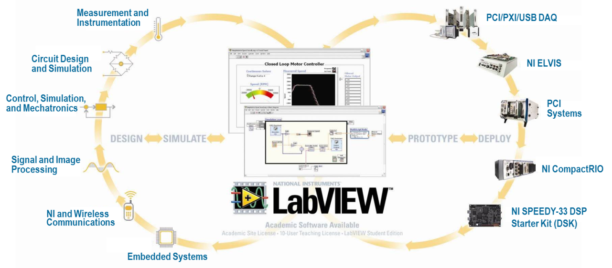
Instructional Approach
Engineering Laboratories
Laboratory Virtual Instrumentation Engineering Workbench
2ndIITEEC 2019’ International Instructional Technologies in Engineering Education Conference, 12th – 13th March 2019 Ege University – Izmir/Turkey

Slide 12
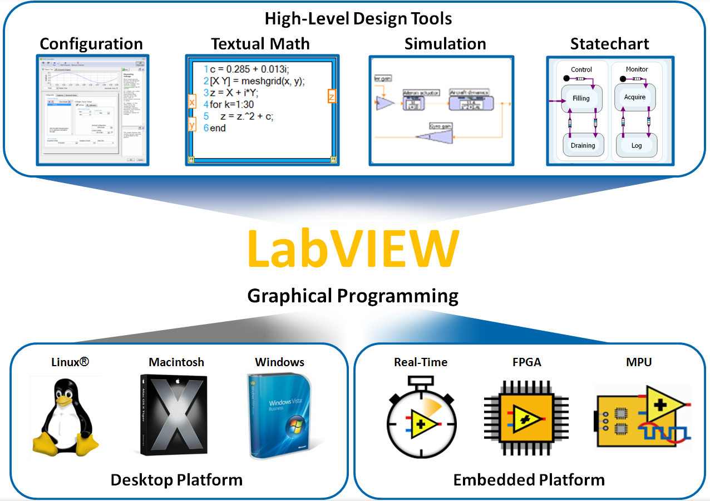
Instructional Approach
Digital Learning Materials
Laboratory Virtual Instrumentation Engineering Workbench
Labview Key Features
Fast Programming
Graphical Programming
Dataflow Representation
Hardware Integration
Advanced Analysis
Signal Processing
Custom Controls
Multiple Targets
Various Design Patterns
Multicore Programming
Execution Highlighting
2ndIITEEC 2019’ International Instructional Technologies in Engineering Education Conference, 12th – 13th March 2019 Ege University – Izmir/Turkey

Slide 13
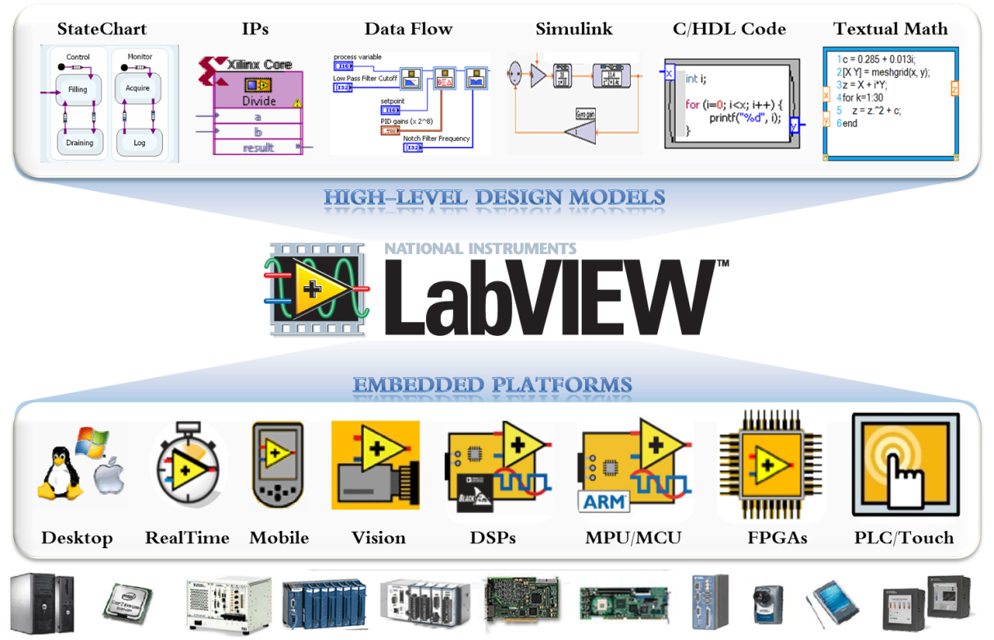
Instructional Approach
Digital Learning Materials
Laboratory Virtual Instrumentation Engineering Workbench
Labview Key Features
Data Stroage and Reporting
Flexible Reporting Tools
Simulation Interface Toolkit
Modulation Toolkit
Math Interface Toolkit
Adaptive Filter Toolkit
Real-Time Vision Development
Robotics Module
C-Code Generator
Microprocessor SDK
Vision Development Module
2ndIITEEC 2019’ International Instructional Technologies in Engineering Education Conference, 12th – 13th March 2019 Ege University – Izmir/Turkey

Slide 14
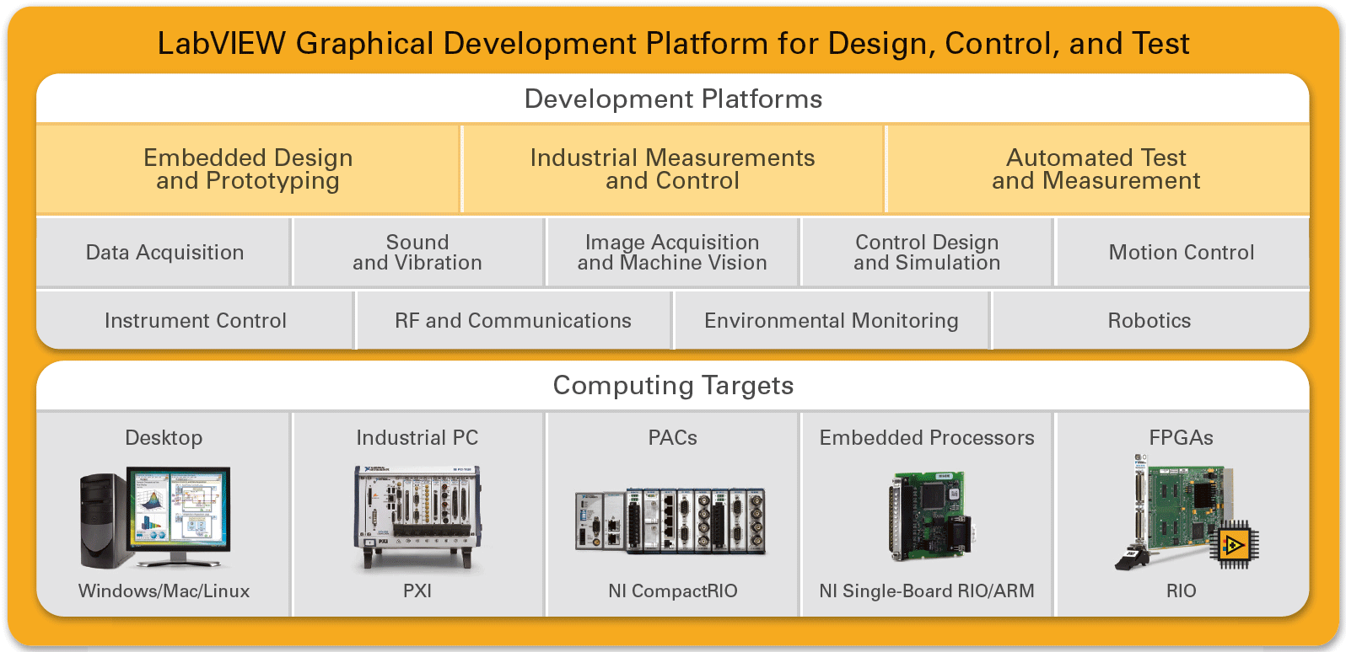
Instructional Approach
Digital Learning Materials
Labview Key Features
Embedded Module for ARM
Digital Filter Design Toolkit
Spectral Measurements Toolkit
Vision Builder for Automated Inspection
PID & Fuzzy Logic Toolkit
System Identification Toolkit
Real-Time Vision Development Bundle
Motion Assistant
Requirements Gateway
2ndIITEEC 2019’ International Instructional Technologies in Engineering Education Conference, 12th – 13th March 2019 Ege University – Izmir/Turkey

Slide 15
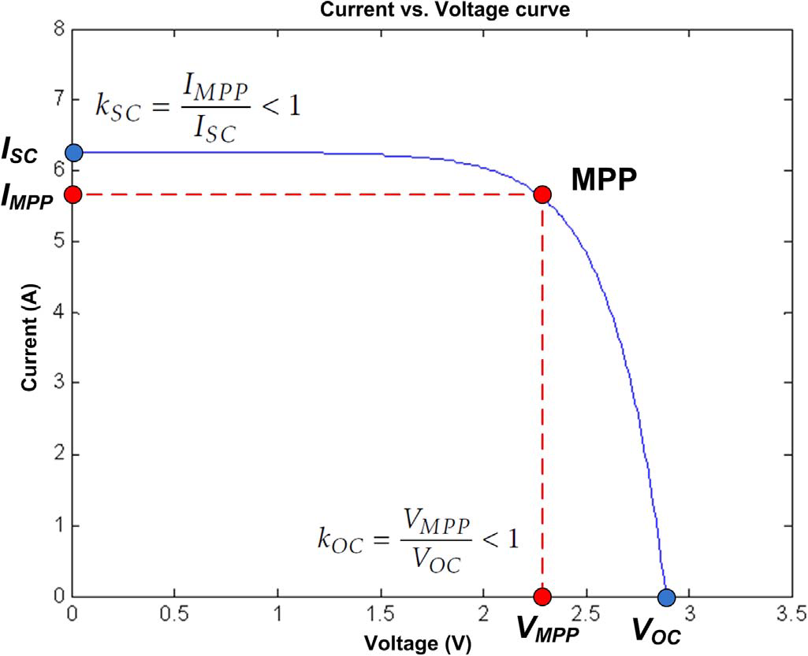
Instructional Approach
Digital Learning Materials
Tracking techniques with constant parameters
Constant voltage method
Open-circuit voltage method
Short-circuit current method
Open-circuit voltage pilot PV cell method
Temperature Gradient (TG) Algorithm
Temperature Parametric (TP) Method
Feedback voltage or current method
P-N junction drop voltage tracking technique
Tracking techniques with measurement and comparison
Look-up table method
Load current or load voltage maximization
Linear current control method
Tracking techniques with trial and error
The only-current photovoltaic method
PV Output Senseless (POS) control method
Perturb and Observe (P & O) method
Modified P & O with fixed perturbation step
Conventional P & O with adaptive perturbation
Modified P & O with adaptive perturbation
Three-point weight comparison method
On-Line MPP search algorithm
DC-Link capacitor droop control
Array Reconfiguration Method
MPPT with a variable inductor
Tracking techniques with mathematical calculation
State-based MPPT method
Linear reoriented coordinates method
Curve-fitting method
Differentiation method
Slide control method
Current sweep method
dP/dV or dP/dI feedback control
Incremental Conductance method
Variable step incremental conductance method
Variable step-size incrementalresistance method
Parasitic capacitance (PC) method
β method
IMPP and VMPP computation method
Methods by modulation
Ripple correlation control
Tracking techniques with intelligent prediction
Fuzzy logic control
Neural network
Biological swarm chasing algorithm
Laboratory and practical work are characteristic features of an undergraduate degree programme in any engineering discipline to demonstrate the presented methods for mppt
2ndIITEEC 2019’ International Instructional Technologies in Engineering Education Conference, 12th – 13th March 2019 Ege University – Izmir/Turkey

Slide 16
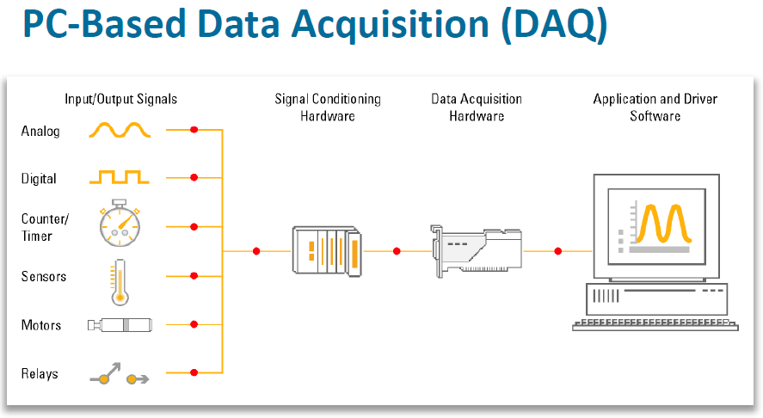
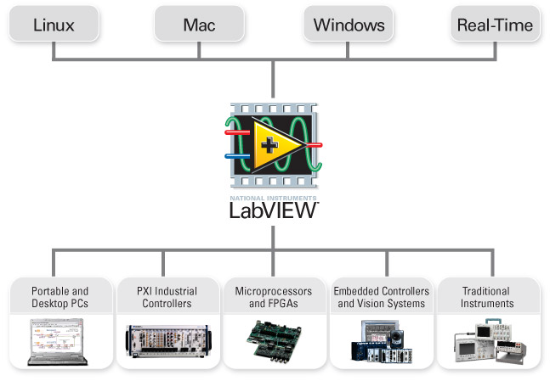
Instructional Approach
Digital Learning Materials
The role and benefits of practical work in the engineering curriculum are to: motivate students and stimulate their interest in the subject; help them to deepen their understanding through relating theory to practice; provide opportunities for students to work together on analysing and solving engineering problems; develop skills and attitudes that will enable graduates to operate effectively and professionally in an engineering workplace.
Aims and learning outcomes
Knowledge and understanding
Intellectual abilities
Practical skills
General transferable skills
2ndIITEEC 2019’ International Instructional Technologies in Engineering Education Conference, 12th – 13th March 2019 Ege University – Izmir/Turkey

Slide 17





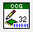






LABVİEW
Report Generation & Data Storage
Control Design & Simulation
Real-Time Module
Embedded Design
Image & Signal Processing
FPGA Module
Industrial Monitoring
& Control
Software Development
& Deployment
DSP Module
Embedded Module for ARM
2ndIITEEC 2019’ International Instructional Technologies in Engineering Education Conference, 12th – 13th March 2019 Ege University – Izmir/Turkey

Slide 18
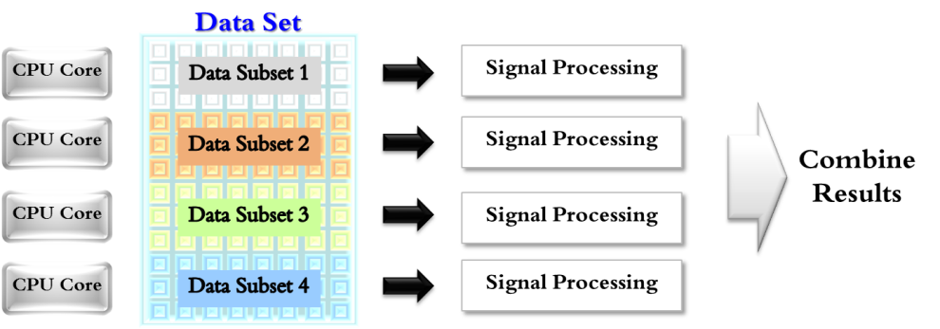
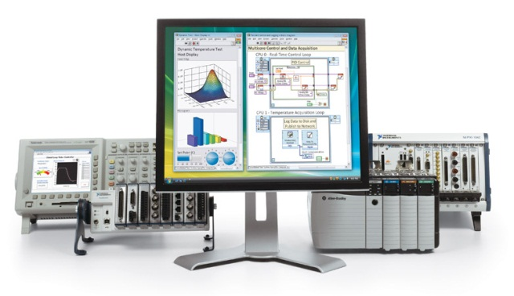
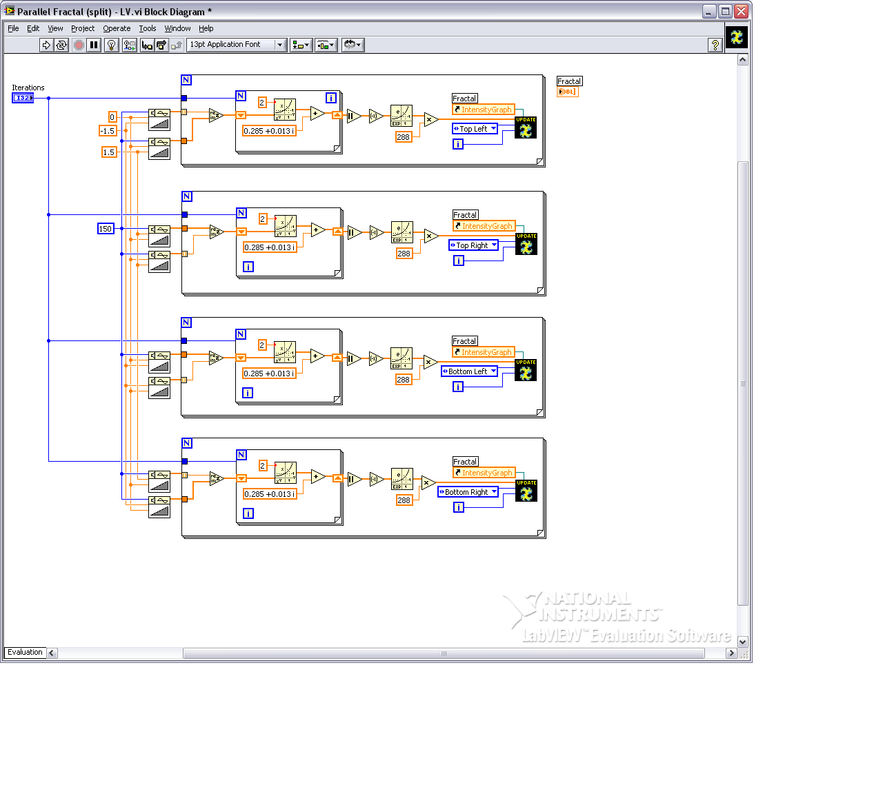
LABVİEW
Faster Programming !
Graphical Programming
Program with drag-and-drop, graphical function blocks instead of writing lines of text.
Dataflow Representation
Easily develop, maintain, and understand code with an intuitive flowchart representation
2ndIITEEC 2019’ International Instructional Technologies in Engineering Education Conference, 12th – 13th March 2019 Ege University – Izmir/Turkey

Slide 19

LABVİEW
Programming Languages Timeline
Simulink
Flow
Code
Agilent
VEE
Performance
C
BASIC
PHP
C++
HDL
LabVIEW
High Level Graphical Languages
Assembly
High Level Textual Languages
00101
10100
Low Level Languages
Abstraction
Machine Code
2ndIITEEC 2019’ International Instructional Technologies in Engineering Education Conference, 12th – 13th March 2019 Ege University – Izmir/Turkey

Slide 20
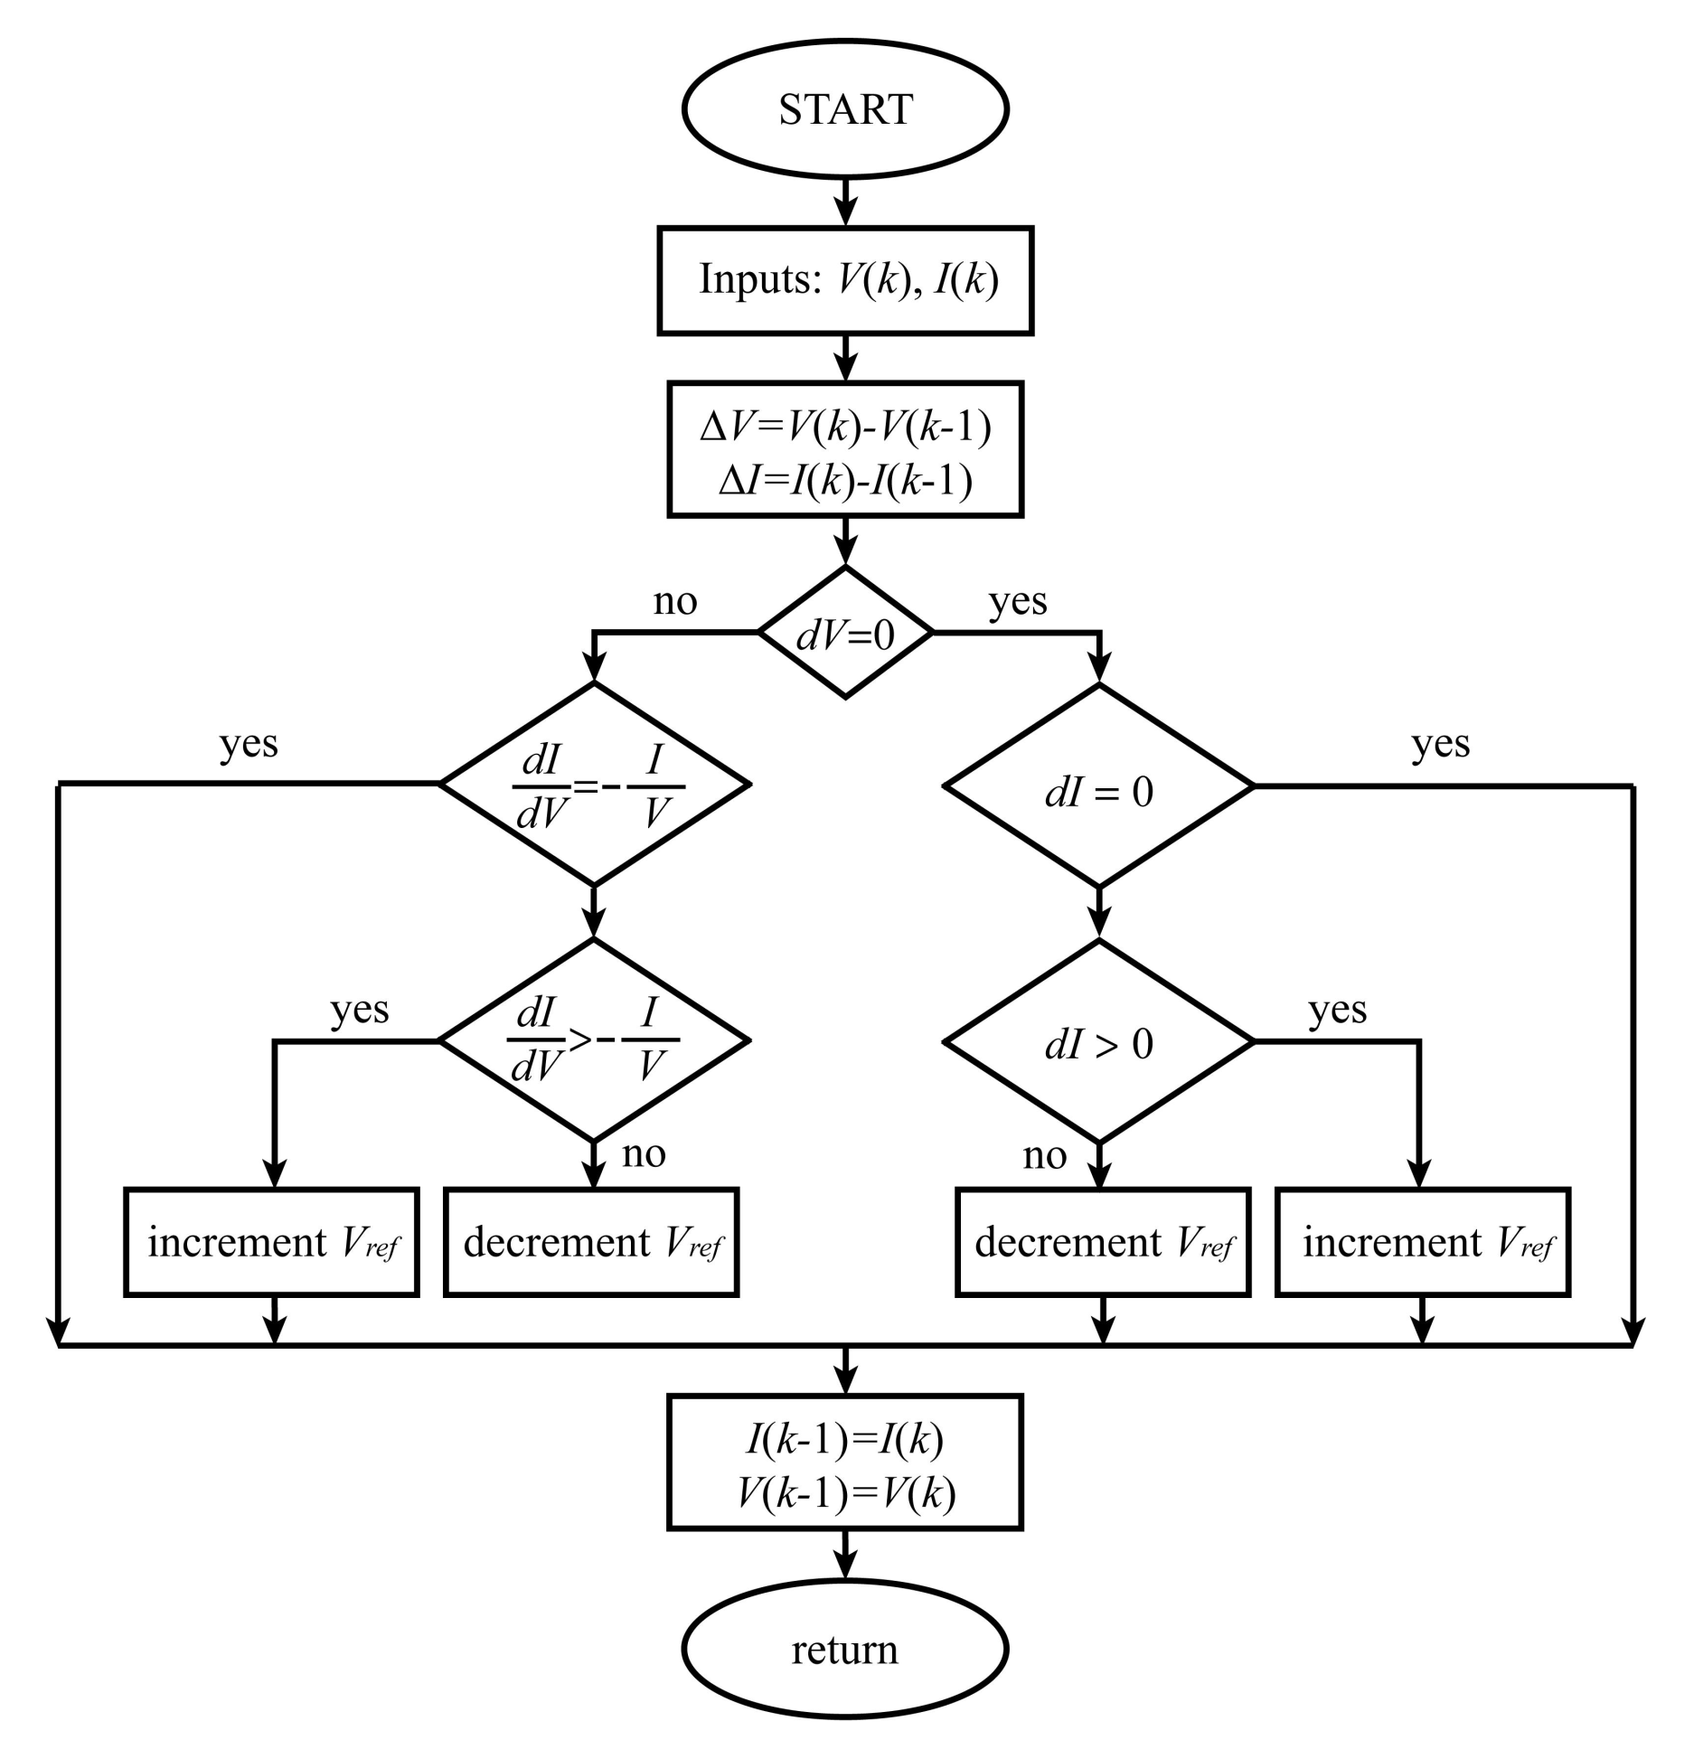
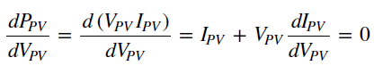
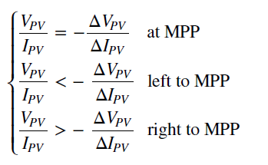
Experimental Results
Incremental Conductance Method
The Incremental Conductance (IC) method consists in differentiating the PV power with respect to voltage.
MPP is located when the differentiation result is zero:
2ndIITEEC 2019’ International Instructional Technologies in Engineering Education Conference, 12th – 13th March 2019 Ege University – Izmir/Turkey

Slide 21
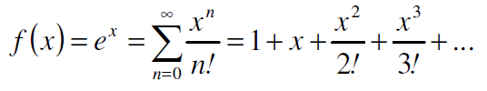
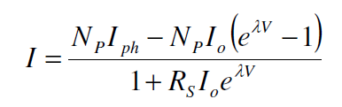
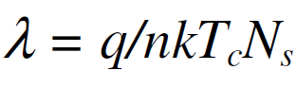
Experimental Results
Mathimatical Anaylsis
Numerical methods such as the Newton Raphson’s method have been widely applied to solve this equation. A different approach is made in order to establish an explicit form of this equation. When a Taylor series is utilized to represent the function f(x)= ex as a power series, the approximation will be:
Since The equivalent circuit for the solar module arranged in Np parallel and Ns series identical cells
No Analytical Solution !
If the same Taylor series representation is used for this equation, taking into account only the first two parts of the series (first order approximation - FOA), the PV module output current can be determined by solving the following equation, Assuming that RS is given by the PV module manufacturer or otherwise previously determined and RP = ∞
2ndIITEEC 2019’ International Instructional Technologies in Engineering Education Conference, 12th – 13th March 2019 Ege University – Izmir/Turkey

Slide 22

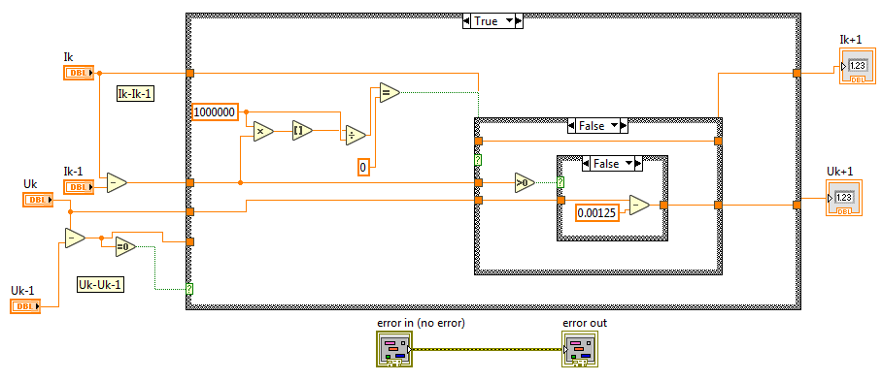

Experimental Results
Labview-Block Diagram
2ndIITEEC 2019’ International Instructional Technologies in Engineering Education Conference, 12th – 13th March 2019 Ege University – Izmir/Turkey

Slide 23

Experimental Results
Labview-Block Diagram
2ndIITEEC 2019’ International Instructional Technologies in Engineering Education Conference, 12th – 13th March 2019 Ege University – Izmir/Turkey

Slide 24

Experimental Results
Labview-User Interface
Behind This interface there is multi Sub-VIs embedded as a block diagram to implement this interface !
2ndIITEEC 2019’ International Instructional Technologies in Engineering Education Conference, 12th – 13th March 2019 Ege University – Izmir/Turkey

Slide 25
Conclusion
One of the main goals of this paper is to trying to increase the effectiveness of digital learning materials using Labview platform for designing new systems.
The proposed system is designed, simulated, and experimentally tested for tracking the maximum power point of photovoltaic modules.
The GUI interface enables user to define and rearrange the monitored variables easily.
The software can be expanded to match larger PV modules with the same implemented method for project oriented engineering education.
The proposed system is reliable, expandable and has excellent performance as a virtual learning platform.
A new mathematical model of a solar panel was presented through educational analytics.
The verification and validation of the simulated results for the I-U curves included comparison of the data from the technical specification and I-U curve at STC of the panel provided by the manufacturer.
The accuracy of the model was calculated and it can be concluded that the model gives an accurate representation of the characteristics of the real solar panel which indicate to the digital inclusion.
40 different mppt methods has been suggested to be implemented as technology integration in engineering education laboratories.
2ndIITEEC 2019’ International Instructional Technologies in Engineering Education Conference, 12th – 13th March 2019 Ege University – Izmir/Turkey

Slide 26
References
Chander, S., Purohit, A., Sharma, A., Arvind, Nehra, S. P., Dhaka M. S.: A Study on Photovoltaic Parameters of Mono-crystalline Silicon Solar Cell with Cell Temperature, Energy Reports, 1, pp. 104–109 (2015).
Chikate, B. V., Sadawarte, Y. A.: The Factors Affecting the Performance of Solar Cell, IJCA Proceedings on International Conference on Advancements in Engineering and Technology, No. 1, 2015, pp. 4–8.
Jaleel, J. A., Nazar, A., Omega, A. R.: Simulation on Maximum Power Point Tracking of the Photovoltaic Module Using LabVIEW, International Journal of Advanced Research in Electrical, Electronics and Instrumentation Engineering, 1 (3), pp. 190–199 (2012).
Gang, Y., Ming, C.: LabVIEW Based Simulation System for the Output Characteristics of PV Cells and the Influence of Internal Resistance on It, WASE International Conference on Information Engineering, Taiyuan, Chanxi, 2009,. pp. 391–394.
Srinivas, P., Lakshmi, K. V., Ramesh, C.: Simulation of Incremental Conductance MPPT Algorithm for PV Systems using LabVIEW, International Journal of Innovative Research in Electrical, Electronics, Instrumentation and Control Engineering, 4 (1), pp. 34–38 (2016).
BlueSolar Monocrystalline Panels catalogue, Victron Energy. https://www.victronenergy.com/upload/documen ts/Datasheet-BlueSolar-Monocrystalline-Panels-EN.pdf, accessed 29.3.2016
Wikipedia contributors. Coefficient of Determination, Wikipedia, The Free Encyclopedia. https://en.wikipedia. org/wiki/Coefficient_of_determination,accessed,30.3.20 16
Singh, P., Ravindra, N. M.: Temperature dependence of solar cell performance and analysis, Solar Energy Materials & Solar Cells, 101, pp. 36–45 (2012).
2ndIITEEC 2019’ International Instructional Technologies in Engineering Education Conference, 12th – 13th March 2019 Ege University – Izmir/Turkey

Slide 27

That’s all. Thank you!
Any Questions?

